Slide 1
Products and Features
SafetyStock ExpreSS
SafetyStock ProfeSSional
MRP Practitioner
Shanghai Ying Bi Lie IT Company Ltd your safetystock.guru

Slide 2
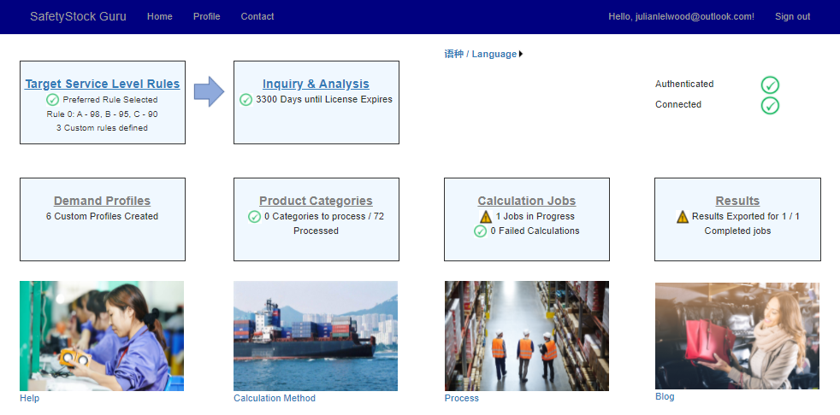
SafetyStock ExpreSS
Establish or sanity check broad safety stock rules for your business
Cloud based – no software to load
Secure - users authenticated by Microsoft ID
Accessible immediately after purchase
NB These functions are only enabled with SafetyStock ProfeSSional

Slide 3
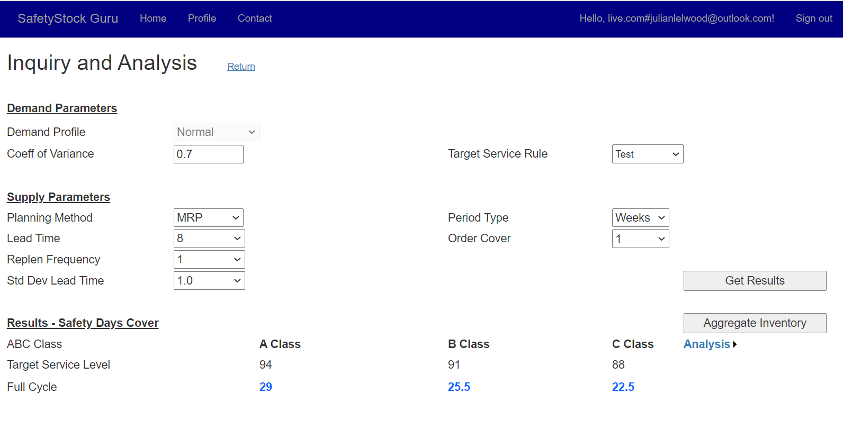
SafetyStock ExpreSS
Calculates desirable level of safety stock for a combination of:
Target service level
Demand accuracy
Lead time
Supplier reliability
Order size and frequency
Forecast horizon (within which all demand firm)
Planning method (MRP / Reorder point)

Slide 4
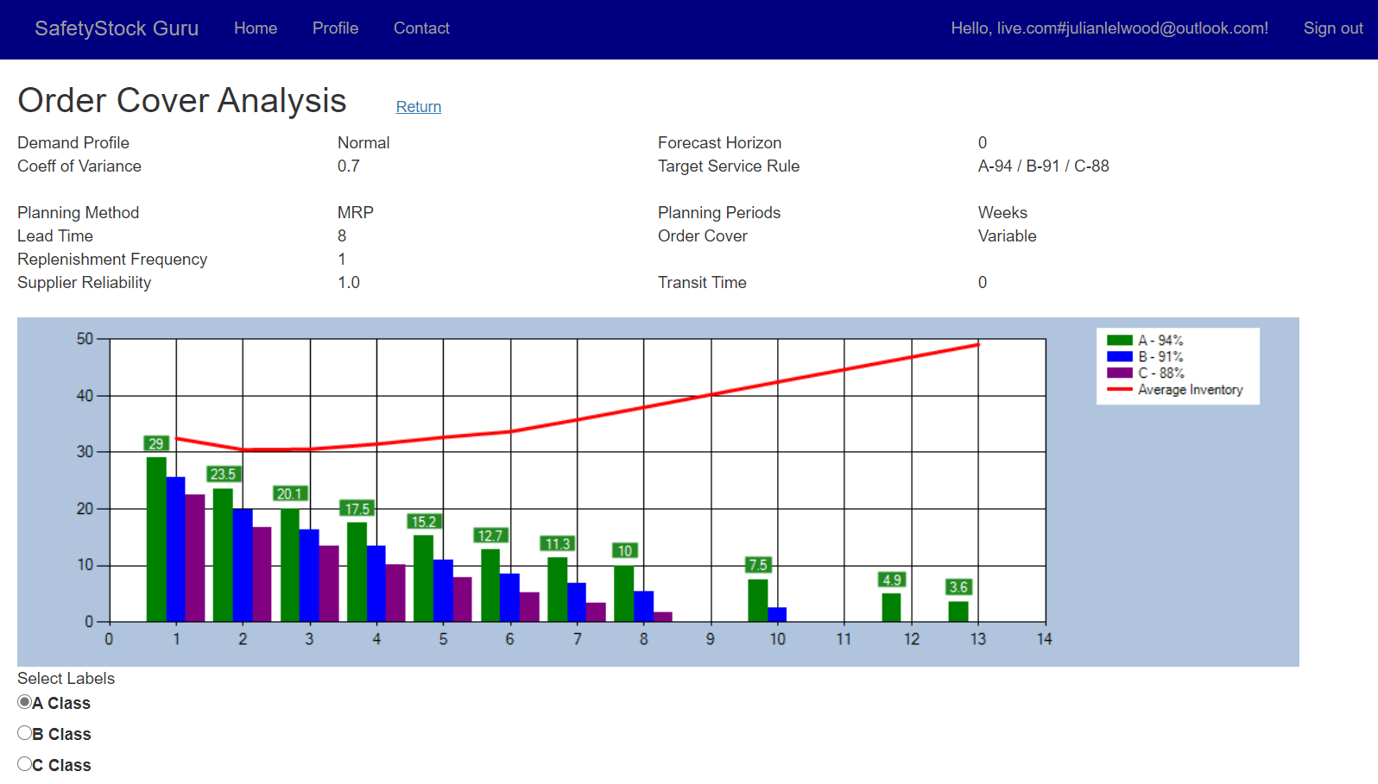
SafetyStock ExpreSS
Sensitivity analysis
Target service level
Lead time
Demand accuracy
Supplier reliability
Order cover

Slide 5
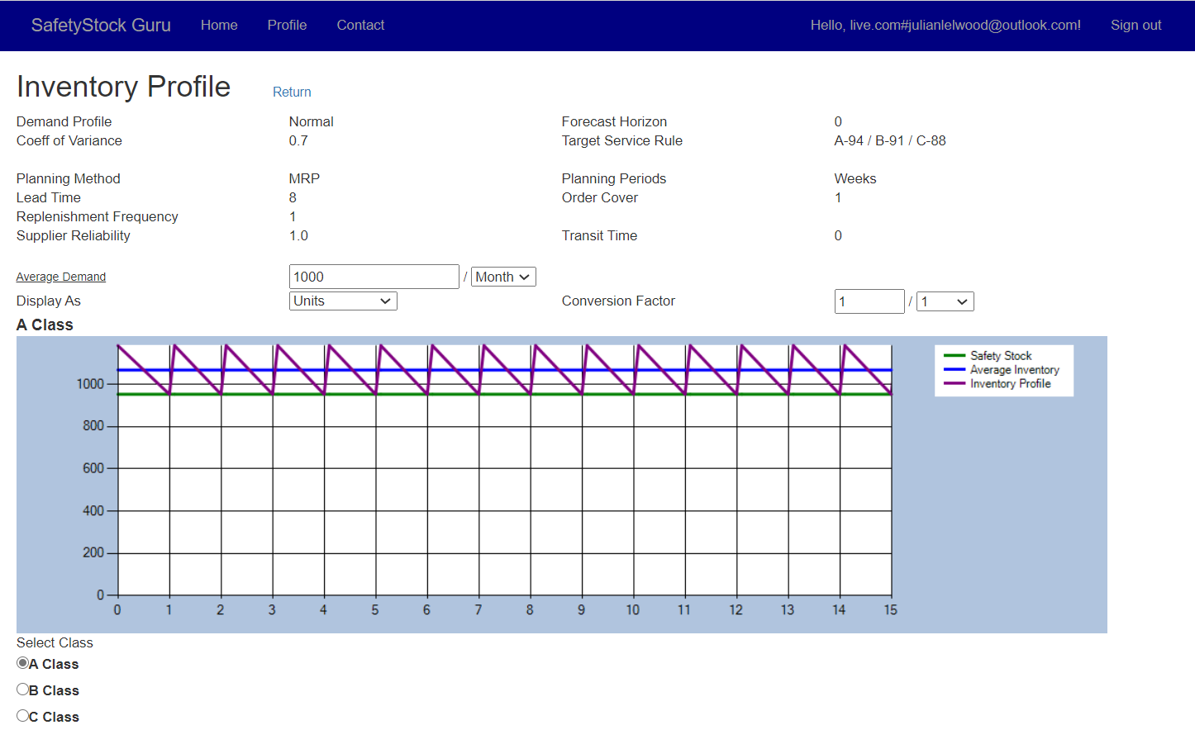
SafetyStock ExpreSS
Inventory profile simulation
Shows proportions of desirable inventory for
Safety stock
Cycle stock
Quick simulation of
Quantity
Value
Volume

Slide 6
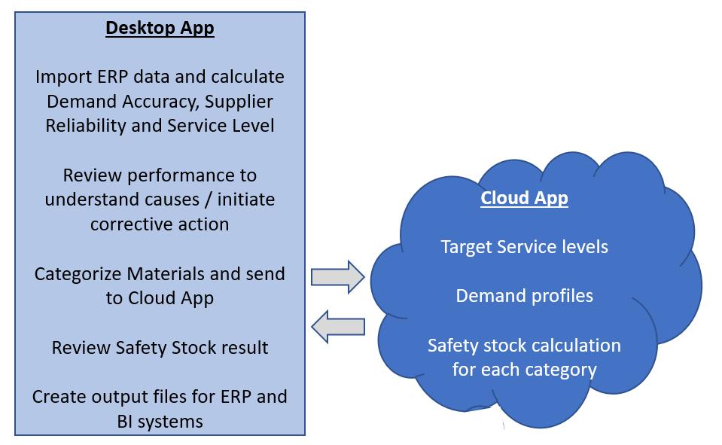
SafetyStock ProfeSSional
Supports the full process for managing inventory levels and inventory optimization projects
Ideal for businesses wanting to enhance their process without disruptive and expensive system changes
Comprehensive user guide covering inventory optimization strategy and tactics as well as app functionality
App has two components keeping your business data on your network
Desktop app (Code signature verification by Sectigo)
Analyses performance
Manages safety stock reviews
Categorizes materials
Outputs ERP parameters
Cloud app
Calculates safety stock levels

Slide 7
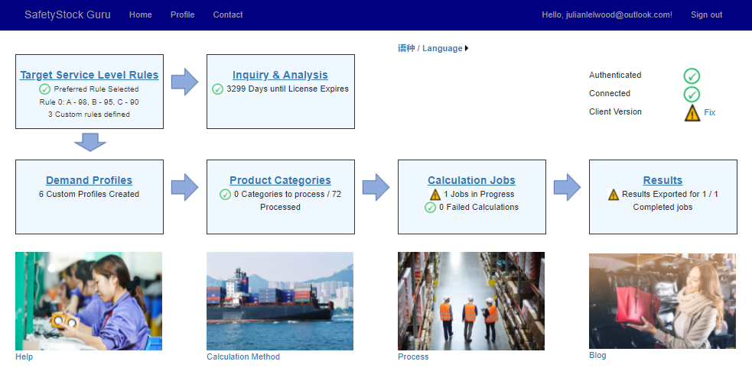
SafetyStock Professional
Cloud App
Builds on SafetyStock ExpreSS
Complex demand profiles
Seasonality
Abnormal orders
Batch calculation for multiple categories / materials
Data interchange with desktop app

Slide 8
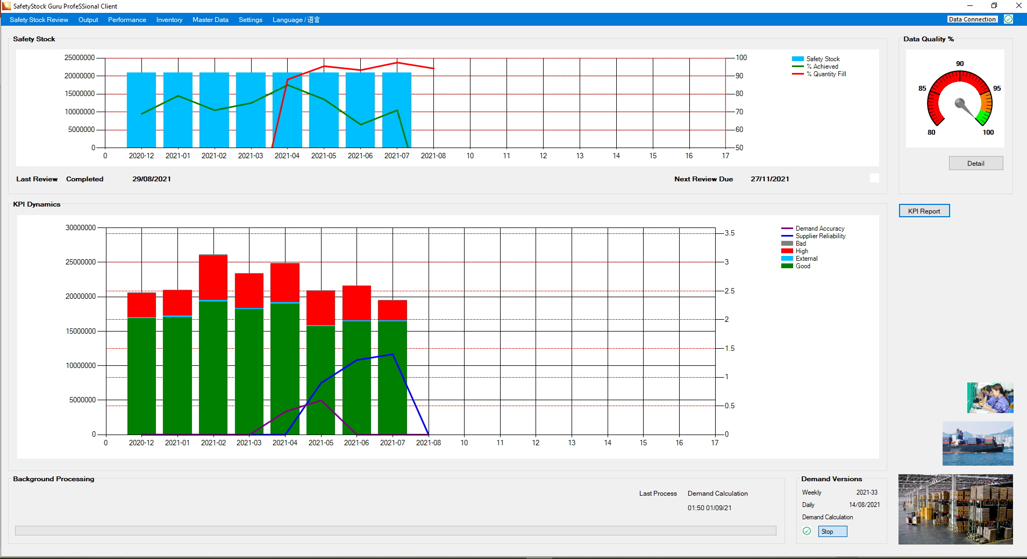
SafetyStock Professional
Desktop App makes progress and issues highly visible
Each instance can manage around 10,000 material/ plant combinations *
Highly configurable process
Your business may already have good measurement and oversight for one or more of the KPIs needed in which case the metrics can be imported simplifying use
Convenient data import
Must fit in with your existing ERP/BI systems
Careful data validation in the background
* Depends on process complexity – contact us to check sizing

Slide 9
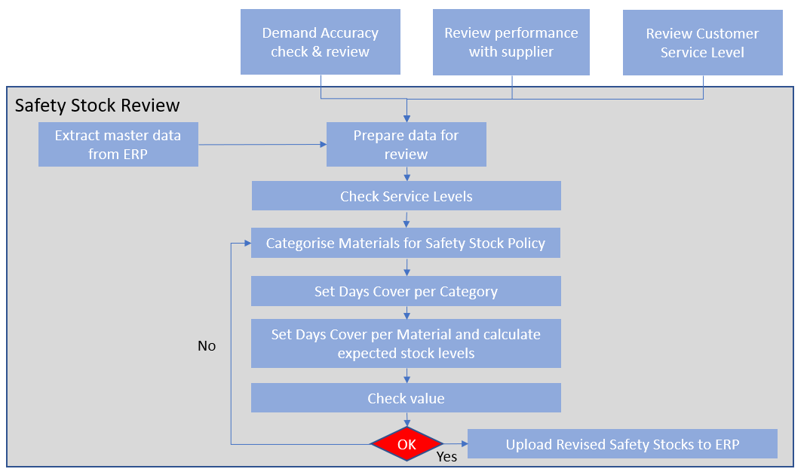
SafetyStock Professional
Review Process
Supports our recommended process for reviewing safety stock levels
Frequency for review and periods of history to be used in each review are configurable

Slide 10
SafetyStock Professional
Performance measurement calculations
Configurable frequency for each measure to fit with S&OP or supplier reviews and provide measures for use in safety stock review process. If metrics are available in existing systems these can be imported.
Demand accuracy
CoV between actual demand and forecast at start of cumulative lead time
MAPE and bias for comparison
Supplier reliability
Standard deviation of difference – original requested receipt versus actual
Actual versus planning lead time
Service level
Quantity fill
OTIF for comparison
Comprehensive root cause analysis to identity service level due to inventory – very important to ensure we don’t build safety stock to cover for other issues not related to stock availability

Slide 11
SafetyStock Professional
Support for manufacturing and distribution businesses
Support multiple plants
Explodes BOM and uses interplant distribution links in demand accuracy
Cumulative lead times can be calculated or imported
ABC and XYZ Classification
ABC classification based on value of future demand can be calculated or imported
XYZ classification based on frequency of demand is integral to the app
Optional use of Safety Time policy to prevent unwanted inventory
New products/ materials
Phaseout products/ materials
Materials with unreliable forecast (from ABC and XYZ)
Optional use of daily planning periods for very fast moving materials e.g.
Food products with short shelf lives
High volume components with daily call off (and likely Kanban control)

Slide 12
SafetyStock Professional
Safety stock output for ERP
Excel or csv format
Scheduled or on demand
ERP Parameters for safety stock method, safety stock quantity/ time and days cover
Net change or
All materials
Time phased safety stocks
Days cover or
Quantity
BI output
ABC /XYZ dimensions
Source dimension
Supplier reliability key figures

Slide 13
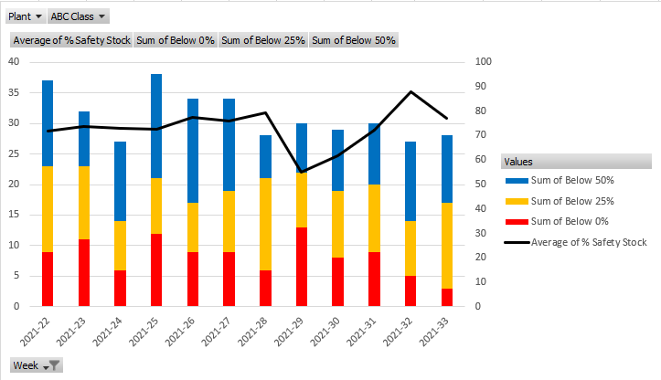
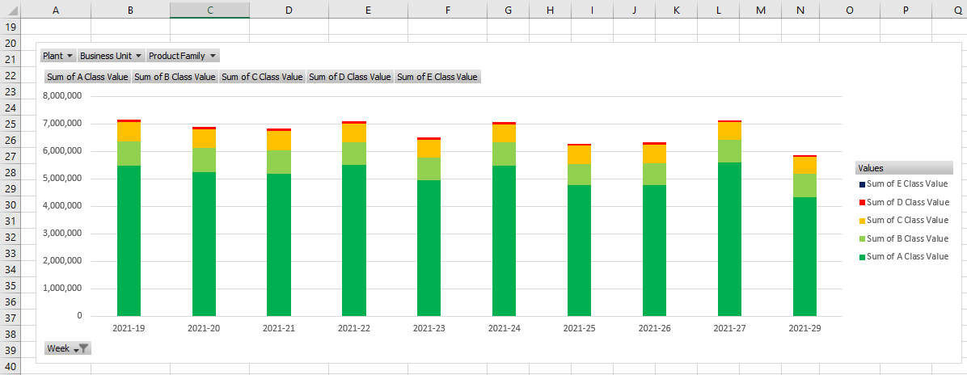
SafetyStock Professional
Closing the loop – actual inventory
Safety stock attainment
Average %
Number of material /plants
Below 50% of target safety stock
Below 25% of target safety stock
Stocked out
Inventory evolution
By ABC or
By Inventory Quality
Good
Safety stock
Cycle stock
High – above entitlement
Bad
Excess
Obsolete
Blocked
External (if reconciliation with Financial inventory desirable)
In transit
Customer consignment
At vendor

Slide 14
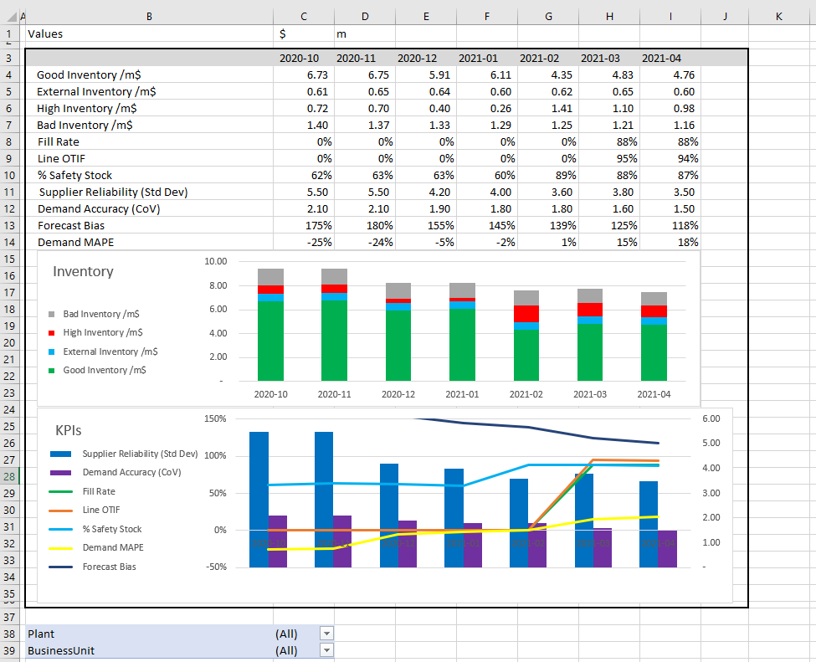
SafetyStock Professional
KPI Dynamics – Getting full value from metrics in the app
Presents the evolution of KPIs covering:
Inventory value
Good/ High/ Bad/ External inventory
Customer service
Quantity fill
Optionally OTIF, On time or Line fill
Demand accuracy
CoV
Bias
Optionally MAPE, Weighted accuracy (deviation from average of forecast and actual)
Supplier reliability
Standard deviation of original request versus actual delivery
Drill down by plant, business unit and product family

Slide 15
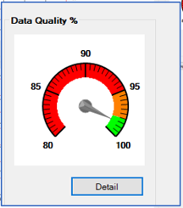
SafetyStock Professional
Data Integrity
Just as for ERP systems data integrity is very important for inventory optimization
Error, warning and informational messages available for each data import
Data required for each of the processes used in your configuration is analysed and an aggregate measure displayed

Slide 16
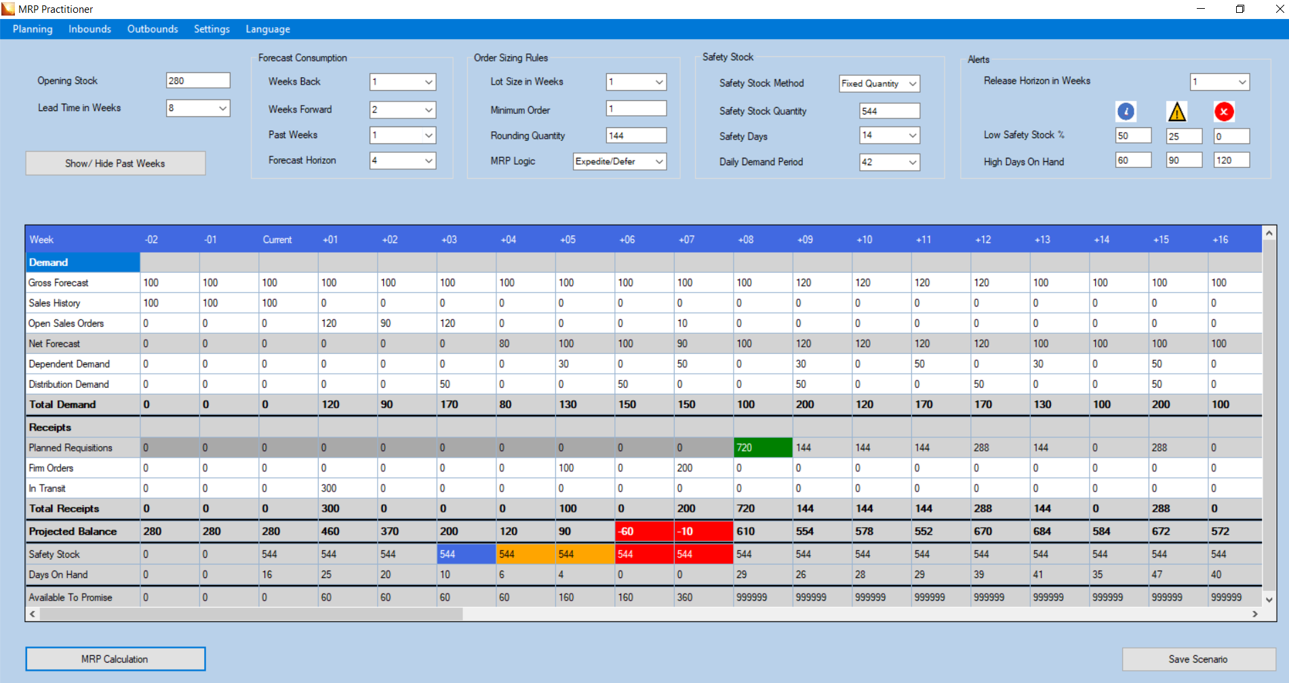
MRP Practitioner
Protects investment in MRP training by providing
Sandbox with all key figures, parameters and alerts on one page
Guidance notes covering all of these important components
Desktop app giving fast response, course guide available in our cloud app.

Slide 17
The End
Merci
xiè xiè
Dank u
ありがとう
Thank you
谢谢
Tack
Gracias
Tak
Vielen Dank
Grazie
Dziękuję
Ying Bi Lie your safetystock.guru

